Slide 1

A Project Report on
Machine Learning Techniques for Accurate Flight Delay Forecasting
submitted in the partial fulfillment of the requirements for the award of the degree of
BACHELOR OF TECHNOLOGY
In
COMPUTER SCIENCE AND ENGINEERING
By
Devangam Harathi 212G1A0571
Shaik Sohail 222G5A0514
Madiga Shireesha 212G1A0594
K. Kiran Kumar 212G1A0591
V. Adi Keshava Reddy 212G1A05C1
V. Pradeep Kumar Naik 212G1A05B9
Under Supervision of
Dr. K. BHARGAVI M. Tech, Ph.D.
Associate Professor & HOD, Department of Computer Science and Engineering
ANANTHA LAKSHMI INSTITUTE OF TECHNOLOGY AND SCIENCES
Approved by AICTE, New Delhi & Affiliated to J.N.T.U. Ananthapuram, Accredited by
NAAC Near S.K. University, Itikalapalli(V), Anantapur (Dt) – 515 721.A.P.

Slide 2
CONTENTS:
1. Abstract
2. Introduction
3. Existing Systems
4. Proposed Systems
4.1 Flight delay prediction model
4.2Advantages
4.3 Software and Hardware Requirements
4.4 Modules
4.5 System Architecture
5. System Design
5.1 DFD Diagram
5.2 Use Case Diagram
5.3 Sequence Diagram
6. Test cases
7. Results
8. Conclusion
9. References

Slide 3
ABSTRACT
Flight delays pose critical challenges to the aviation industry, impacting passengers, airline operations, and regional economies.
The project introduces a flight delay prediction system that applies various machine learning algorithms to historical flight data. The objective is to accurately forecast potential delays and evaluate the performance of models such as Logistic Regression, Decision Trees, Random Forest, and Gradient Boosting.
By analyzing real-world datasets, the system provides airlines with tools to improve operational planning, enhance passenger satisfaction, and reduce delay-related costs.

Slide 4
2. INTRODUCTION
Flight delays have become a significant challenge for passengers, airlines, and airports, impacting both efficiency and economics. According to the Bureau of Transportation Statistics, approximately 20% of airline flights are delayed.
The project leverages machine learning techniques to predict flight delays more accurately than traditional statistical methods. By analyzing historical flight data—including schedules, weather, and traffic conditions—we compare models like Logistic Regression, Decision Tree, Random Forest, and Gradient Boosting to determine the most effective predictors.
Our goal is to provide a scalable, real-time system that enhances flight planning, minimizes delays, and improves passenger experience.

Slide 5
3.EXISTING SYSTEM
The existing system for flight delay management mainly relies on historical data analysis and conventional statistical models. Here's a breakdown of the limitations and methods currently used:
Traditional Statistical Methods: In the current system, basic statistical methods such as linear regression or time-series analysis are often used to predict delays based on a limited set of features such as flight time and historical delays.
Manual Processes: Airlines often rely on manual processes or basic scheduling software to manage delays, often reacting to delays rather than predicting and proactively mitigating them.
Limited Data Utilization: Current systems may not fully utilize available data such as weather conditions, air traffic data, airline-specific delays, or airport traffic, which are crucial for predicting delays more accurately.

Slide 6
4. PROPOSED SYSTEMS
The proposed system aims to predict flight delays using machine learning models trained on historical flight data.
The dataset is sourced from the Bureau of Transportation Statistics (BTS), U.S., containing detailed records of domestic flights, making it a credible and comprehensive resource for aviation data analysis.
The system utilizes supervised learning techniques to analyze flight schedules and real-time arrival data, significantly improving the accuracy of flight delay predictions.
The main objective of this project is to predict flight delays. By considering various parameters related to flight schedules and operations. The project also focuses on designing an effective flight delay prediction model.

Slide 7
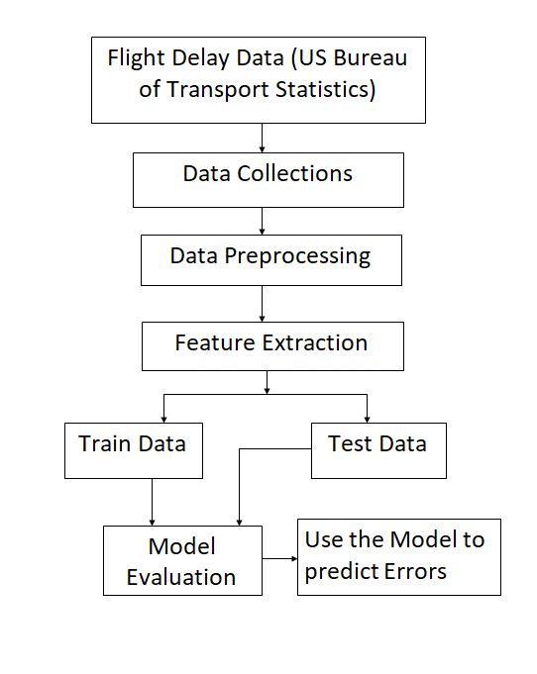
4.1 Flight delay prediction model:
Implements a structured approach using machine learning algorithms.
Flight Delay Data
The process begins by collecting real-world flight data from the official US BTS database, which includes details like schedule times, delays and more.
Data Collections
Gathering and aggregating relevant features from multiple sources such as flight history, weather reports, and airline schedules.
Data Preprocessing
Removing missing values
Handling outliers and duplicates
Normalizing or standardizing feature

Slide 8
Feature Extraction
Selecting important inputs (features) that impact delay prediction:
Date, airline, airport, time of day
Taxi-out time, day of week, weather
Train Data / Test Data Split
Dataset is divided into:
Training Set – used to teach the model
Testing Set – used to evaluate model accuracy
Typically, 80% for training and 20% for testing
Model Evaluation
The trained model is tested using the test data and evaluated using:
Confusion matrix: A table that summarizes the performance of a classification model by comparing actual and predicted values
Evaluation Metrics: Accuracy
Precision
Recall
F1-Score

Slide 9
4.2 Advantages
Higher Accuracy
Real-Time Predictions
Scalable Solution
Better Passenger Experience
Automation & Efficiency
4.3 Software and Hardware Requirements
Hardware Requirements | Software Requirements
System: Intel Core i7 | Operating System: Windows 10
Hard Disk: 1TB | Coding Language: Python
Monitor: 15” LED | Tools: Py Charm, Visual Studio Code
Input Devices: Keyboard, Mouse | Database: SQLite3
RAM: 16GB

Slide 10
4.4 Modules
User Module
Handles user interface and interaction
Submits input data for prediction
Displays prediction results to users
Admin Module
Manages users and access rights
Monitors system health, data updates, and usage logs
Triggers model retraining when needed
Prediction Module
Preprocesses incoming data
Feeds data into the trained machine learning model
Returns predicted delay results in real time

Slide 11
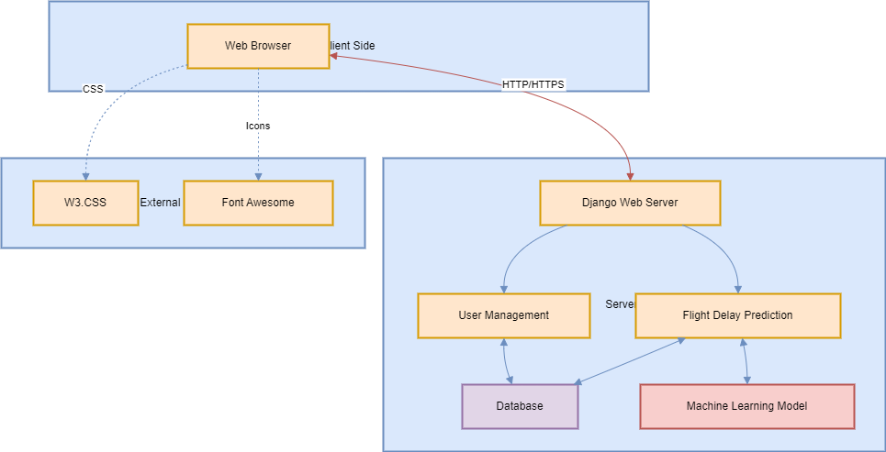
4. 5 System Architecture
Client (Web Browser): UI built with W3.CSS and Font Awesome, communicates via HTTP/HTTPS.
Server (Django): Handles login, registration, and prediction using:
User Management
Prediction Module
Database: Stores user info and flight data.
ML Model : Predicts delays using trained historical data.
Different machine learning models are used to compare performance : Logistic, DT,RF,GB
The accuracy of each model is tested to choose the best one for predictions.
Fig : System Architecture

Slide 12
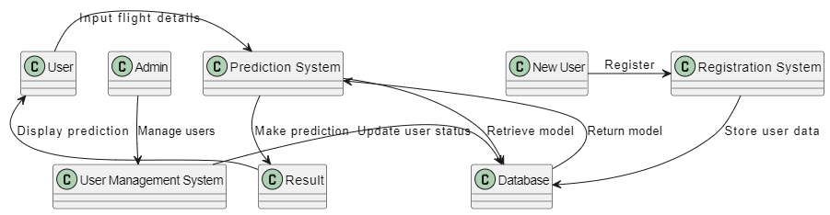
5. SYSTEM DESIGN
5.1 DFD Diagram
Fig : Data Flow Diagram
A DFD shows how data flows through the system:
User enters flight details and views predictions.
Admin manages users via the User Management System.
Prediction System processes inputs, interacts with the Result component and Database.
New Users register through the Registration System, which stores data in the Database.
The Database holds user info and ML models.

Slide 13
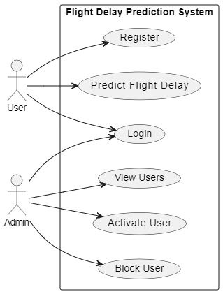
5.2 Use Case Diagram
A use case diagram is a visual representation that shows the interactions between users (actors) and a system to capture its functional requirements.
Actors:
User
Admin
User Use Cases:
Register: Sign up to create an account.
Login: Log in to access the system.
Predict Flight Delay: Enter flight details to get delay prediction.
Admin Use Cases:
Login: Access admin panel.
View Users: See all registered users.
Activate User: Approve user accounts.
Block User: Restrict access for specific users.
Fig: Use Case Diagram

Slide 14
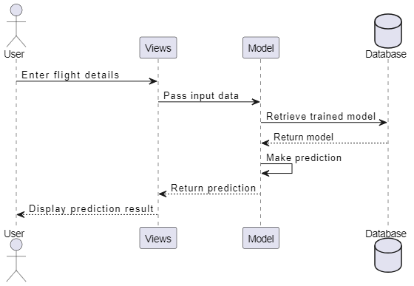
5.3 Sequence Diagram
A sequence diagram is a UML diagram that shows how objects interact in a system over time through the exchange of messages.
This diagram shows how the system predicts flight delays:
User enters flight details.
Views pass data to the Model.
Model retrieves the trained model from the Database.
Prediction is made and sent back to Views.
Views display the result to the User.
Fig : Sequence Diagram

Slide 15
6. TEST CASES
Test Case No. | Test Scenario | Test Steps | Expected Outcome
1 | Valid Input Data | 1. Input valid data for all fields (e.g., FL_DATE, TAIL_NUM, CRS_DEP_TIME). | Form should submit successfully and display prediction result.
 |  | 2. Submit the form.
2 | Invalid Flight Date | 1. Input an invalid or future date for FL_DATE. | The form should reject submission and show an error message like "Invalid date."
 |  | 2. Submit the form.
3 | Missing Required Fields | 1. Leave some required fields (e.g., OP_UNIQUE_CARRIER) blank. | Error messages should indicate missing fields, and no prediction is made.
 |  | 2. Submit the form.
4 | Predicting for Cancelled Flight | 1. Set CANCELLED to 1. | The system should display a message like "Flight is canceled," and no prediction is made.
 |  | 2. Fill other fields with valid data.
 |  | 3. Submit the form.
5 | Invalid Airport ID | 1. Input invalid data for ORIGIN_AIRPORT_ID or DEST_AIRPORT_ID. | Error message should display "Invalid Airport ID."
 |  | 2. Submit the form.
6 | Valid Flight Number Format | 1. Input a valid numeric flight number in OP_CARRIER_FL_NUM. | Form should submit successfully, and a prediction should be displayed.
 |  | 2. Submit the form.

Slide 16
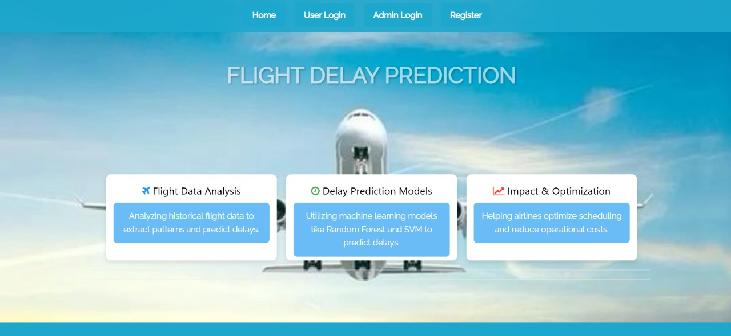
7. RESULTS:
Fig 7.1 Home Page

Slide 17
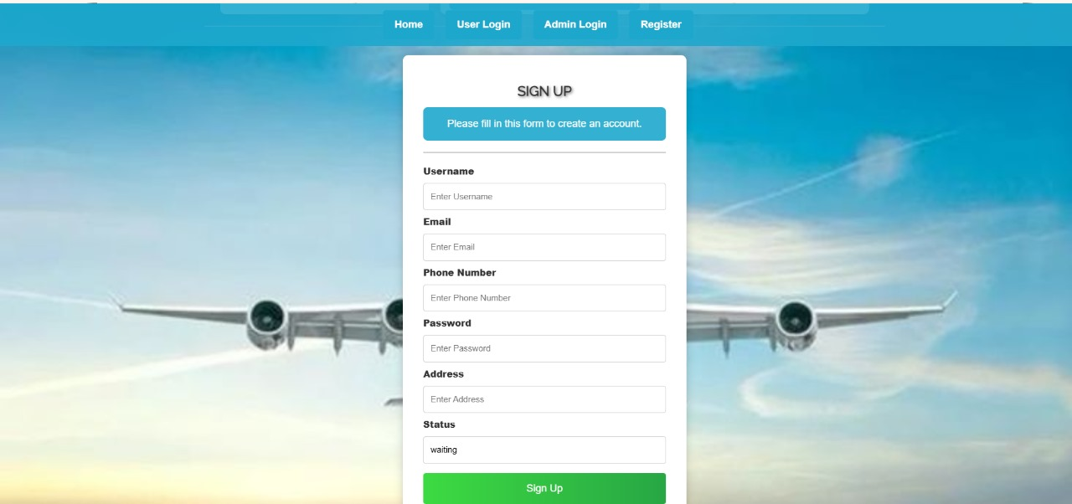
Fig 7.2 User Registration Page

Slide 18
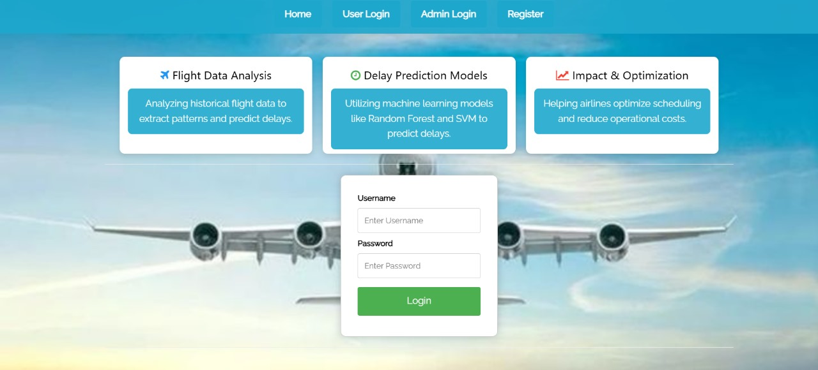
Fig 7.3 User Login Page

Slide 19
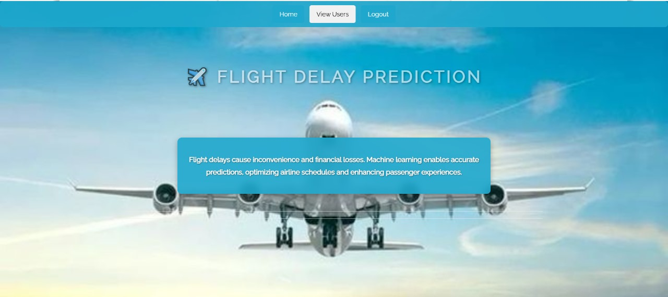
Fig 7.4 Admin Home Page

Slide 20

Fig 7.5 Fig. User Home Page

Slide 21
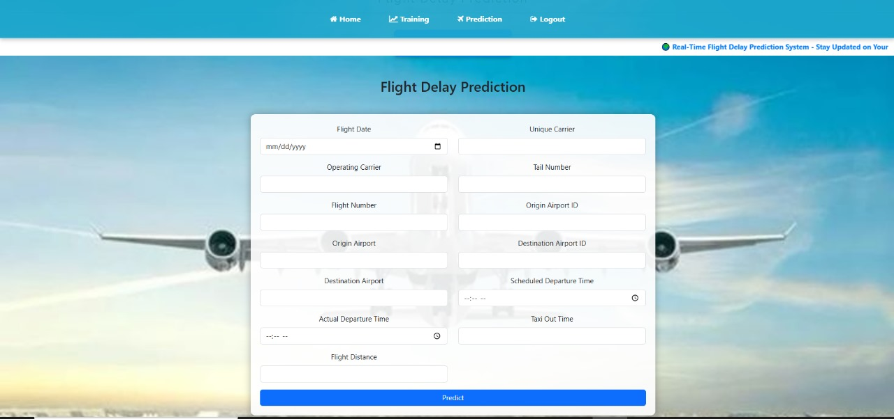
Fig 7.7 Flight Delay Prediction Page

Slide 22
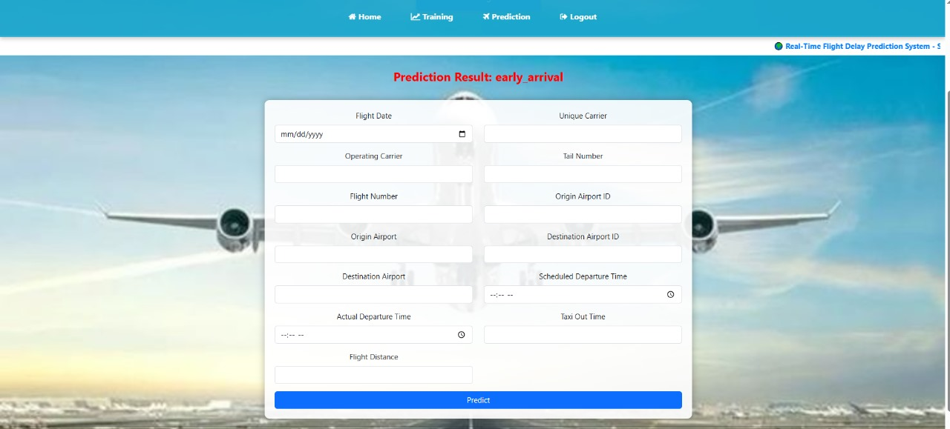
Fig 7.8 Prediction Result

Slide 23

Fig 7.6 Training Result Page

Slide 24
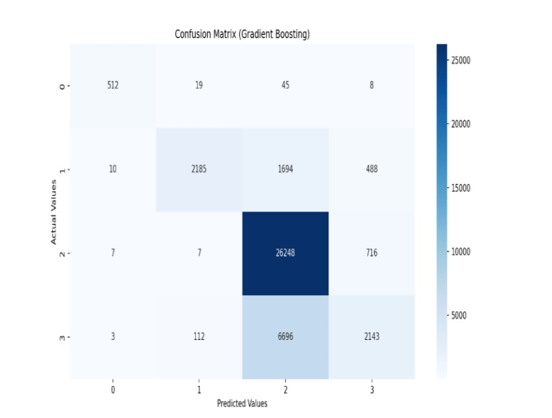
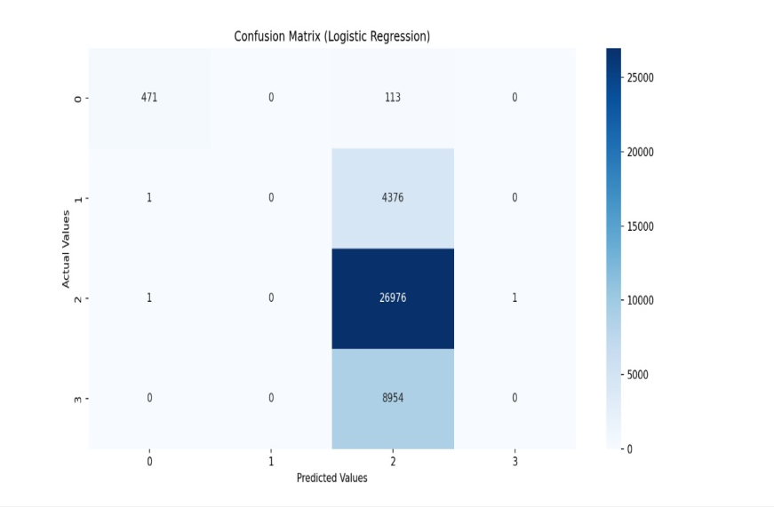
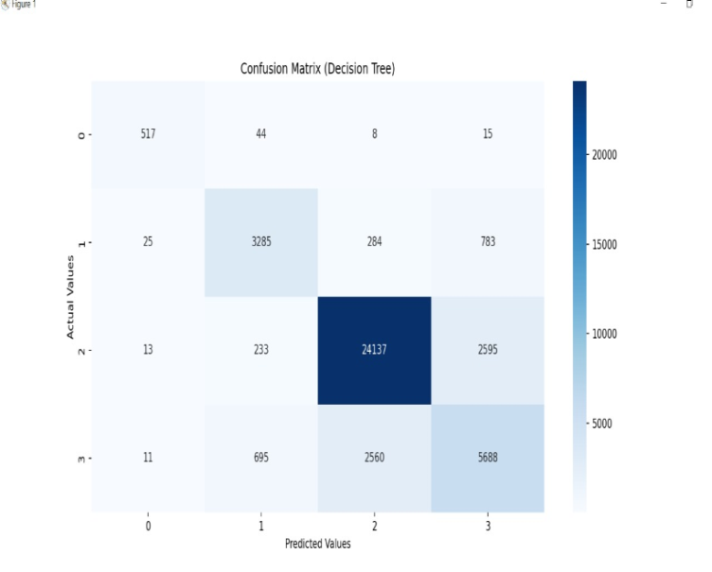
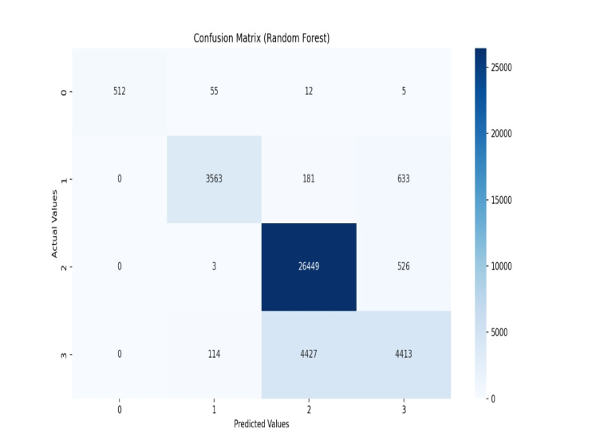
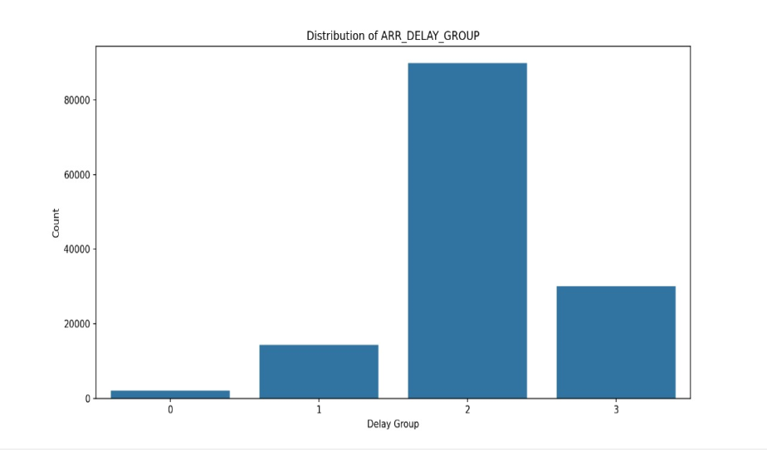
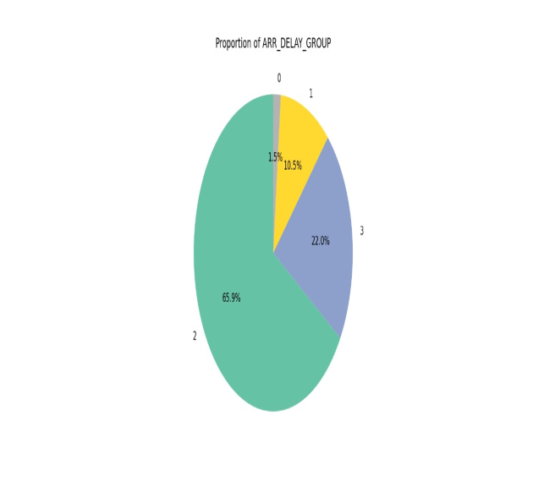
Graphs

Slide 25
8.CONCLUSION
Developed a machine learning-based system to predict flight delays accurately.
Implemented and evaluated multiple models to improve prediction performance.
Built a user-friendly interface using Django for real-time predictions.
Helps airlines and passengers plan better and reduce uncertainty.
Future work includes adding more features and optimizing model accuracy further.

Slide 26
9. REFERENCES
[1] Borse, Y., Jain, D., Sharma, S., Vora, V., and Zaveri, A. (2020) Flight Delay Prediction System. International Journal Of Engineering Research & Technology (IJERT) Volume 09, Issue 03 (March 2020).
[2] Bureau of Transportation Statistics. Available online: https://www.bts.gov/ (accessed on 26 March 2020).
[3] Akpinar, M.T. and Karabacak, M.E. (2017). Data mining applications in civil aviation sector: State-of-art review. In CEUR Workshop Proc (Vol. 1852, pp. 18-25).
[4] Nazeri, Z. and Zhang, J. (2017). Mining Aviation Data to Understand Impacts of Severe Weather. In Proceedings of the International Conference on Information Technology: Coding and Computing (ITCC.02) pp. 518-523.
[5] Ha. ,. J. N. a. H. P. S. Man. (2015) "Analysis of Air-Moving on Schedule Big Data based on Crisp Dm Methodology," ARPN Journal of Engineering and Applied Sciences, pp. 2088-2091.

Slide 27
THANK YOU

